Slide 1

Fixed effects
Felipe Buchbinder

Slide 2

Welcome back! Today we’ll talk about fixed effects. Enjoy!

Slide 3

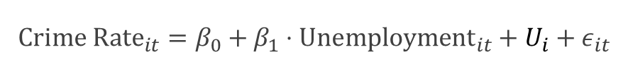
Is unemployment related to crime rate?
$${Crime Rate}_{it}=β_{0}+β_{1}⋅{Unemployment}_{it}+U_{i}+ε_{it}$$

Slide 4

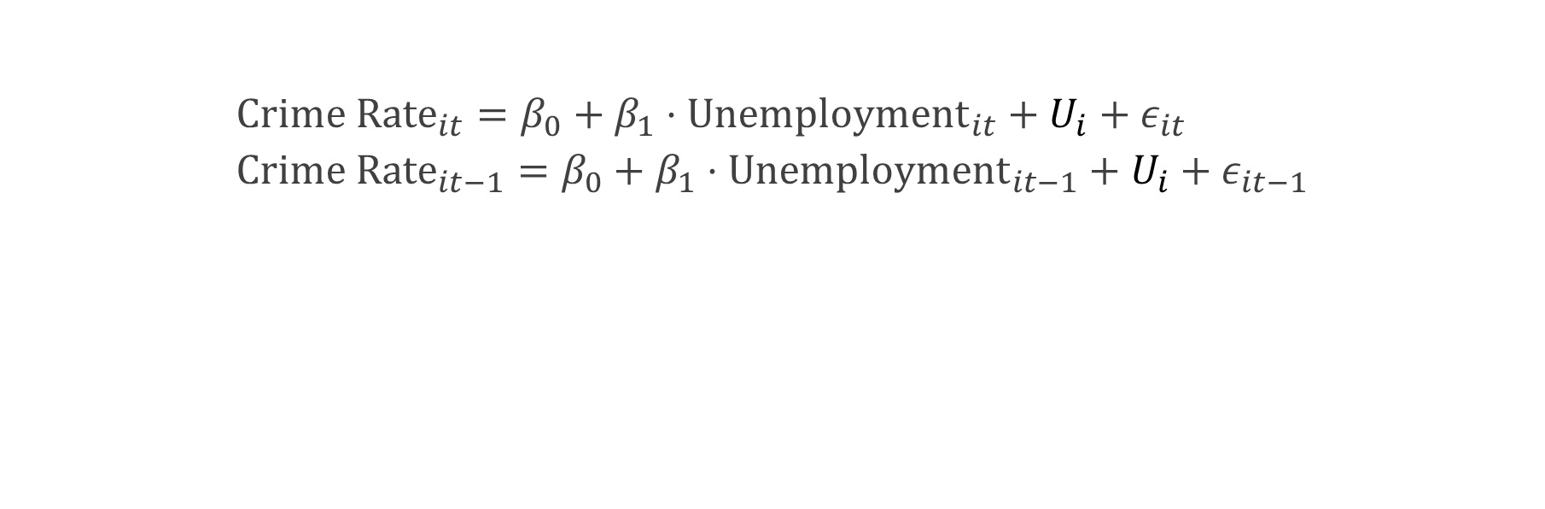

Is unemployment related to crime rate? First difference models compare $t$ with $t−1$ to eliminate $U_{i}$
$${Crime Rate}_{it}=β_{0}+β_{1}⋅{Unemployment}_{it}+U_{i}+ε_{it} \\ {Crime Rate}_{it−1}=β_{0}+β_{1}⋅{Unemployment}_{it−1}+U_{i}+ε_{it−1}$$
$$ΔCrime Rate=β_{1}⋅Δ{Unemployment}_{it−1}+{Δε}_{it}$$

Slide 5

What if the errors are serially independent, in which case a first difference won’t work?

Slide 6

Let’s try a different approach…

Slide 7

Let’s compare each city’s crime rate with the city’s historical (average) crime rate
In other words, we can use deviations from historical averages

Slide 8
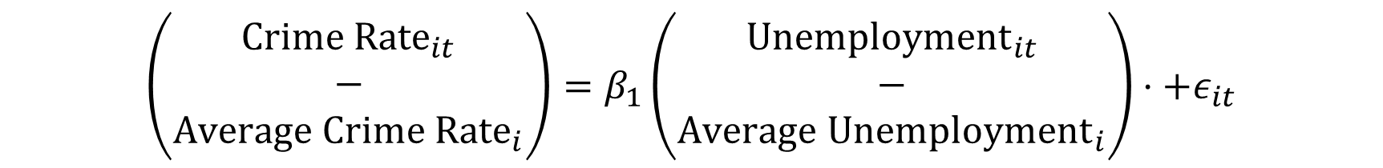
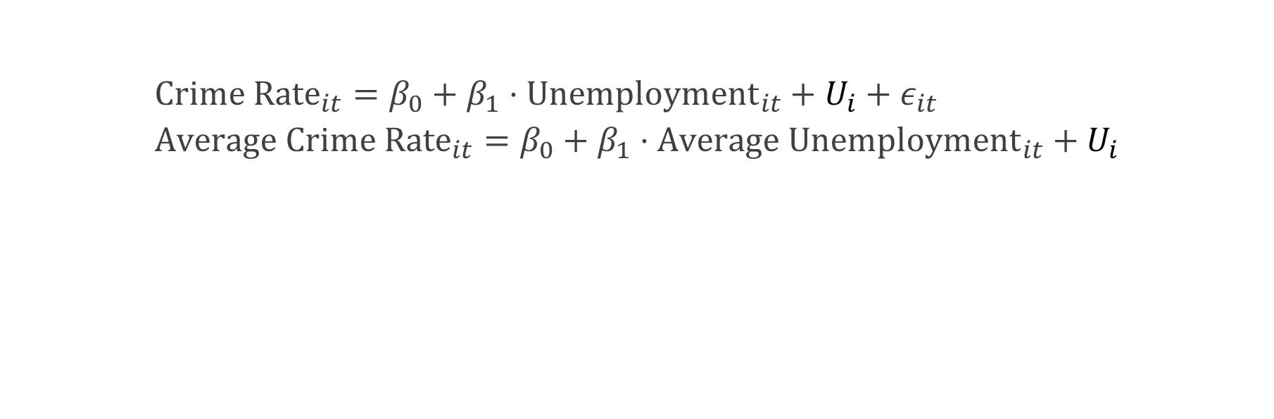
Let’s compare crime rate with the city’s historical (average) crime rate In other words, we can use deviations from historical averages
$${Crime Rate}_{it}=β_{0}+β_{1}⋅{Unemployment}_{it}+U_{i}+ε_{it} \\ {Average Crime Rate}_{it}=β_{0}+β_{1}⋅{Average Unemployment}_{it}+U_{i}$$
$$\left(\begin{aligned}Crime {Rate}_{it} \\ − \\ Average Crime {Rate}_{i}\end{aligned}\right)=β_{1}\left(\begin{aligned}{Unemployment}_{it} \\ − \\ Average {Unemployment}_{i}\end{aligned}\right)⋅+ε_{it}$$

Slide 9

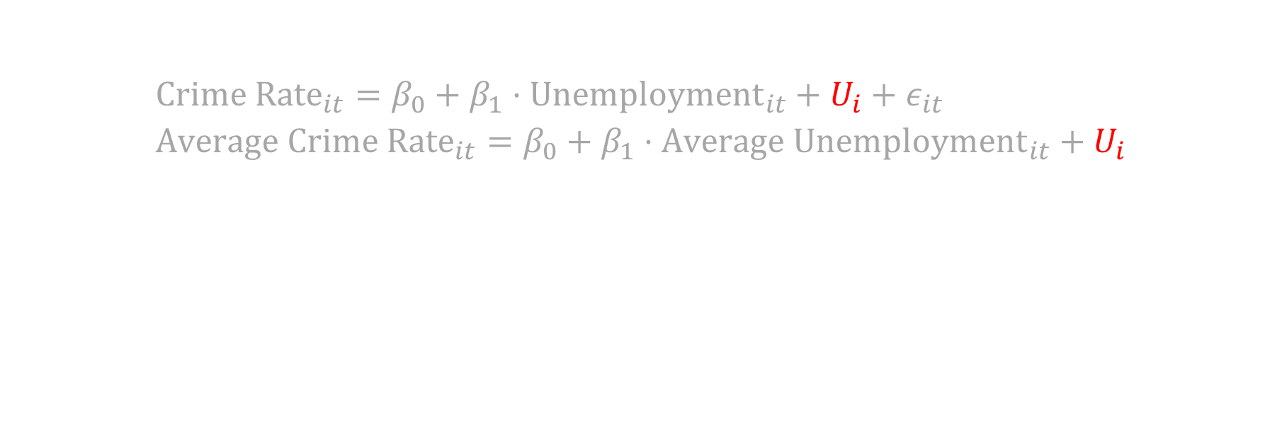
We can also compare crime rate with the city’s historical (average) crime rate In other words, we can use deviations from historical averages
Fixed Effects
$${Crime Rate}_{it}=β_{0}+β_{1}⋅{Unemployment}_{it}+U_{i}+ε_{it} \\ {Average Crime Rate}_{it}=β_{0}+β_{1}⋅{Average Unemployment}_{it}+U_{i}$$
$$\left(\begin{aligned}Crime {Rate}_{it} \\ − \\ Average Crime {Rate}_{i}\end{aligned}\right)=β_{1}\left(\begin{aligned}{Unemployment}_{it} \\ − \\ Average {Unemployment}_{i}\end{aligned}\right)⋅+ε_{it}$$
In this context, the $U_{i}$ are called fixed effects because they does not change through time
and are thus eliminated by considering all values relative to their historical averages for each entity

Slide 10

In the fixed effect model, we eliminate fixed unobserved heterogeneities by focusing on how things deviate from historical average values.

Slide 11

Fixed effects regresses ${\ddot{Y}}_{it}≜Y_{it}−\overline{Y_{i}}$ on $${\ddot{X}}_{it}≜X_{it}−{\overline{X}}_{i}$$

Slide 12

Any questions?

Slide 13
Do you understand how FE is different than FD?

Slide 14


Within transformation
Transforming a variable by subtracting its historical mean
$Y_{it}\underset{→}{within transformation}Y_{it}−{\overline{Y}}_{i}$
$X_{it}\underset{→}{within transformation}X_{it}−{\overline{X}}_{i}$
$ε_{it}\underset{→}{within transformation}ε_{it}$

Slide 15


Reduced equation
The equation relating within-transformed variables
$${\ddot{Y}}_{it}={β\ddot{X}}_{it}+ϵ_{it}$$

Slide 16

Reduced equation
The equation relating within-transformed variables
$${\ddot{Y}}_{it}={β\ddot{X}}_{it}+ϵ_{it}$$
Note that it doesn’t have an intercept. Why?

Slide 17
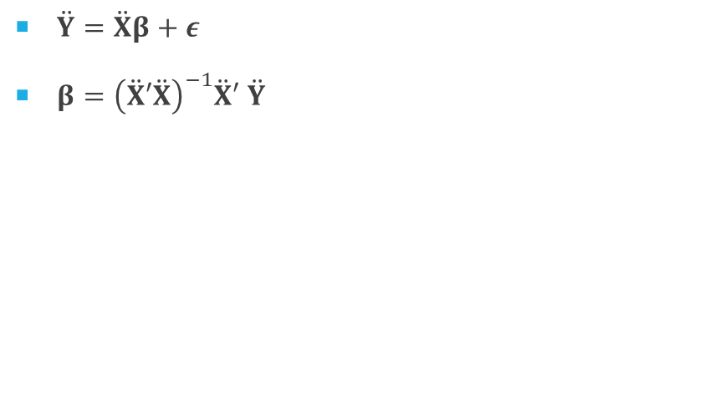
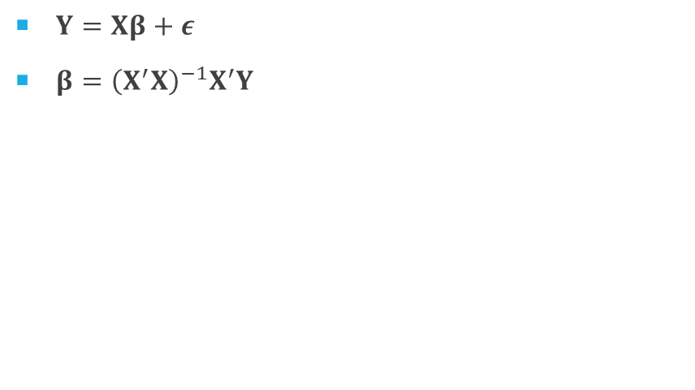
A Fixed effects model works just like OLS regression but with within-transformed variables, rather than actual variables
OLS Regression
Fixed Effects Regression
$Y=Xβ+ε$
$β={\left(X^{′}X\right)}^{−1}X^{′}Y$
$\ddot{Y}=\ddot{X}β+ε$
$β={\left(\ddot{X}′\ddot{X}\right)}^{−1}\ddot{X}′$ $\ddot{Y}$

Slide 18

How are the residuals of the reduced equation related to the residuals of the original equation?

Slide 19
How should the serial correlation of the residuals in the original equation be so that Fixed effects work well?

Slide 20
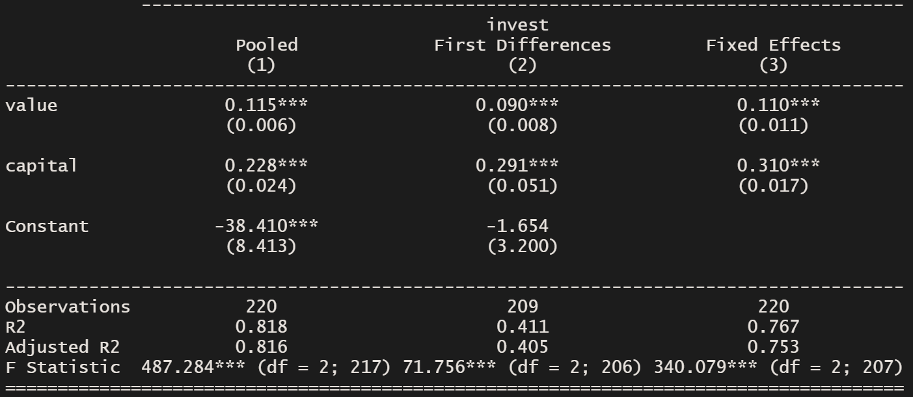
Is investment determined by company value? The Grunfeld dataset
#Pooled regression
pooled <- plm(invest ~ value + capital, index=c(“firm”, “year”), data=Grunfeld, model='pooling’)
#Fixed Effects model
fe <- plm(invest ~ value + capital, index=c(“firm”, “year”), data=Grunfeld, model=“within”)

Slide 21
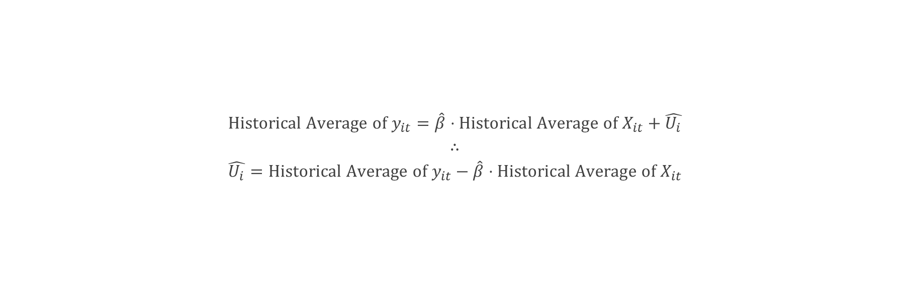
Even though fixed effects vanish, we can still estimate them We’ll have to use the historical average equation
$$Historical Average of y_{it}=\hat{β}⋅Historical Average of X_{it}+\hat{U_{i}}$$
$$∴ \\ \hat{U_{i}}=Historical Average of y_{it}−\hat{β}⋅Historical Average of X_{it}$$

Slide 22

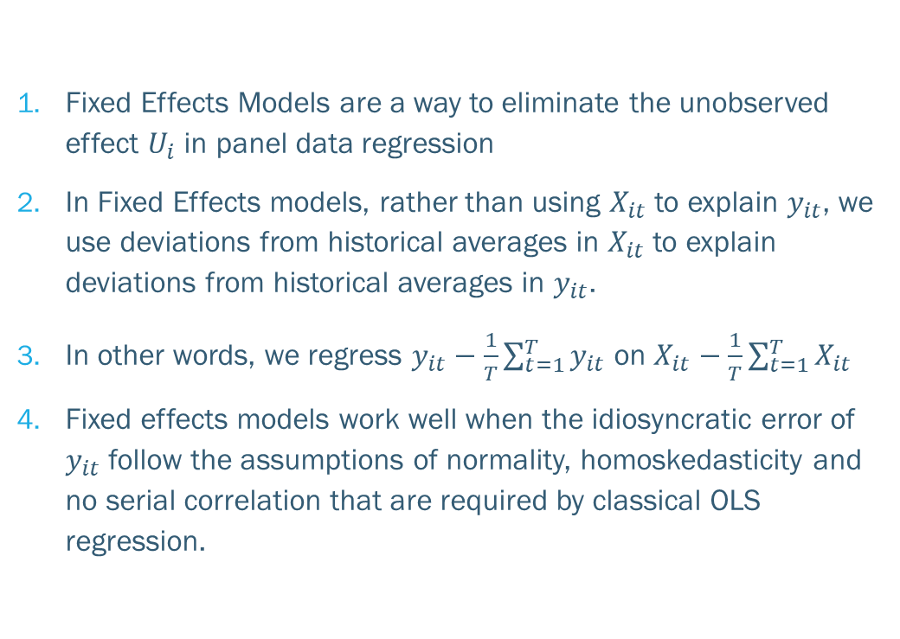
Key takeaways
Fixed Effects Models are a way to eliminate the unobserved effect $U_{i}$ in panel data regression
In Fixed Effects models, rather than using $X_{it}$ to explain $y_{it}$, we use deviations from historical averages in $X_{it}$ to explain deviations from historical averages in $y_{it}$.
In other words, we regress $y_{it}−\frac{1}{T}\sum_{t=1}^{T}{y_{it}}$ on $X_{it}−\frac{1}{T}\sum_{t=1}^{T}{X_{it}}$
Fixed effects models work well when the idiosyncratic error of $y_{it}$ follow the assumptions of normality, homoskedasticity and no serial correlation that are required by classical OLS regression.

Slide 23
Did you like Batman’s explanation of the fixed effects model?

Slide 24
I once met batman in person. We made a video:

Slide 25
